Slide 1


COMPREHENSIVE PLAN
2024 – 2026
NEEDS ASSESSMENT
Notes:
INSTRUCTIONS
This is the COVER of your needs assessment. Delete the placeholder logo and replace it with your county logo. From the Insert tab, select Pictures. Browse to the folder where your “color w white text” logo is stored. Select it and click Open. After the logo appears, double-click it to open the Format tab. Resize by clicking in the Width box and entering 2.5. Align the logo with the needs assessment title below.

Slide 2

Acknowledgments
The Edgefield County First Steps Needs and Resources Assessment process for 2023 began in January 2023 with surveys that were distributed to community partners and parents with young children.
These survey results were tabulated and a report was created. Additional sources were utilized for data reports, including KidsCount, County Health Rankings and Roadmaps from the University of Wisconsin Population Health Institute, the South Carolina Department of Social Services, South Carolina DHEC Vital Records, the South Carolina Education Oversight Committee, and the American Community Survey 5-Year Estimates (2016-2020).
Two community meetings were held in February 2023 with participants attending representing the local school district, local child care providers, Early Head Start, faith community, Adult Education, Family Literacy, local charter school, law enforcement, mental health, and local non-profit organizations. During the first meeting, the attendees reviewed data relevant to young children and their families and brainstormed the vision and values of an early childhood system where all children reach their highest potential.
During the second meeting, the attendees spent time mapping the county resources/assets and identifying needs of the community. The meeting concluded with the group discussing the gaps in the resources.
Edgefield County First Steps wants to acknowledge those who completed surveys as well as the attendees at the two community meetings. All contributions were invaluable as we proceed with the completion of our needs and resources assessment.
“The project described was supported through South Carolina First Steps by the Preschool Development Grant Birth through Five Initiative (PDG B-5), Grant Number 90TP0080-02-01 from the Office of Child Care, Administration for Children and Families, U.S. Department of Health and Human Services.”
Notes:
INSTRUCTIONS. Overwrite text box with acknowledgments if desired

Slide 3
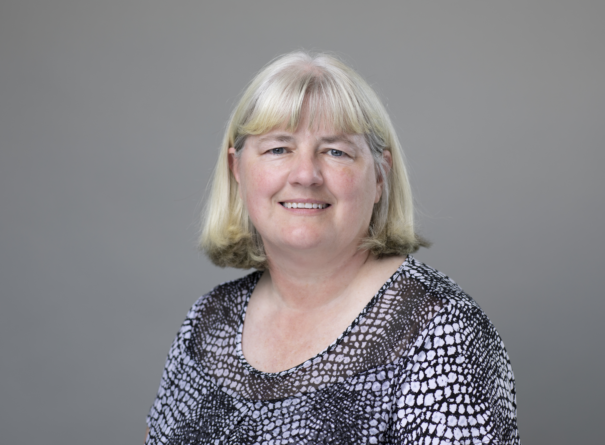
Message from the Executive Director
Candi Lalonde
Executive Director
Edgefield County First Steps
Every three years, the First Steps legislation requires that each First Steps Partnership Board bring the community together to identify the county’s needs and resources. We use this time to review data relevant to the health and well-being of families with young children in our county, ascertain ideas about school readiness of young children, and determine the greatest needs of families with young children.
While we spend time with our community partners and families on a regular basis, our Board and staff look forward to this activity as it affords us the opportunity to formally recognize the resources located in our county and evaluate the needs of the families with young children.
The feedback we receive during this process is used to inform our programs and services for the next three years so that we are better able to meet the needs of families with young children. We do all this in support of our vision that every Edgefield County child will be prepared for success in school.
Candi Lalonde
Notes:
TEXT: Use the text boxes provided to give an introduction to your partnership and outline your goals.
PHOTO & SIGNATURE: Delete the placeholder images and replace them with a high-quality photo and signature. (Insert > Pictures.) Double-click the images to open the Format tab, where you can crop and resize these images. Edit the text box below the ED photo with ED name and partnership name.

Slide 4



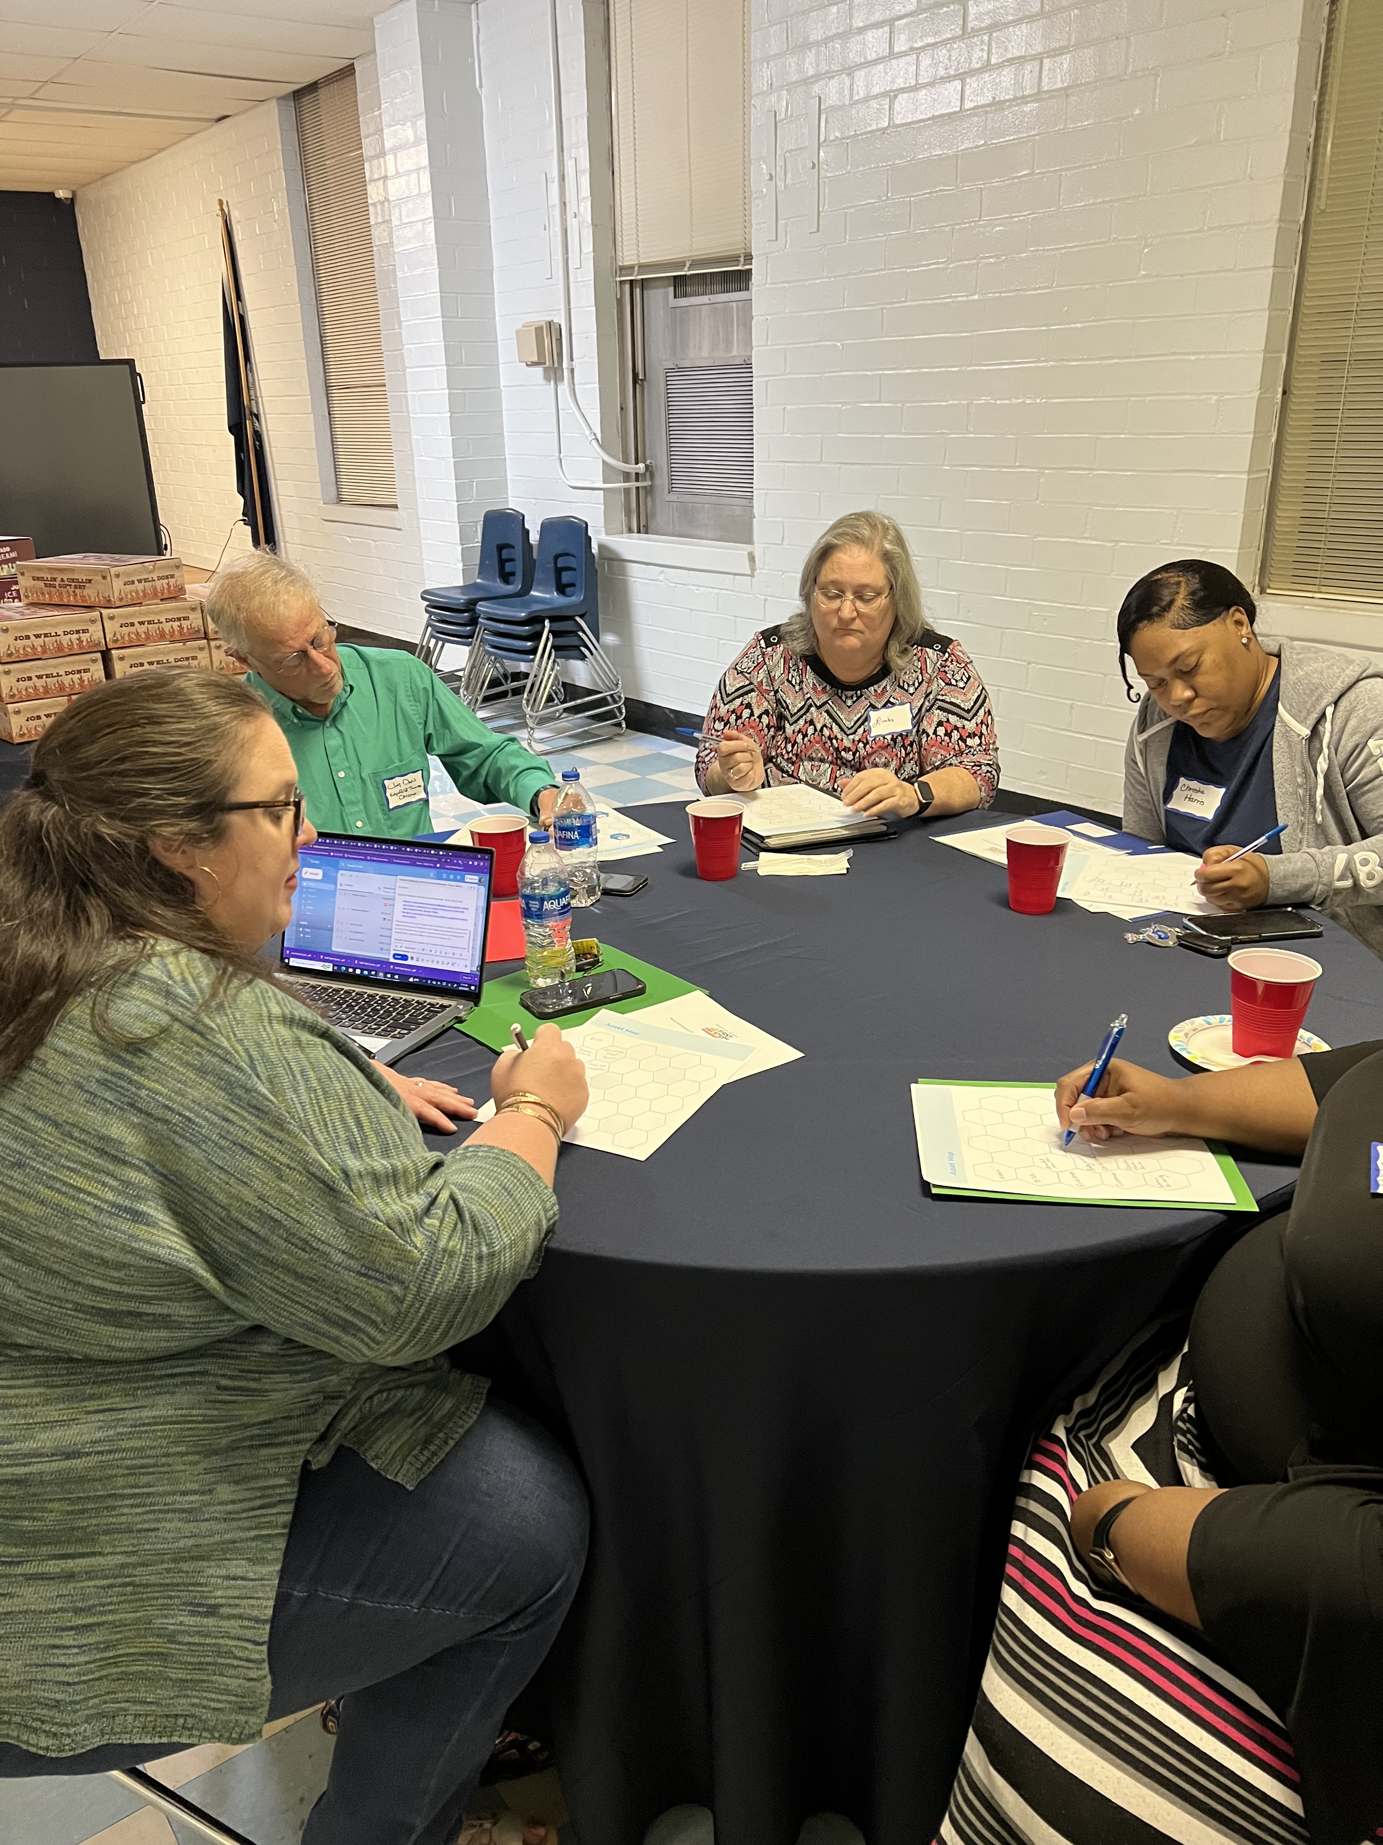
Needs Assessment Process
SURVEY & CONVENE
Distributed over 500 surveys to parents with
young children and community partners
Held two community convenings with 20 participants and developed a vision for young children
and their families
January - February 2023
UNDERSTAND
Reviewed local data and map assets to understand the state of young children, their families, and the early childhood system
January – February 2023
PRIORITIZE
Organized the insight gathered from the convenings and data to prioritize the concerns, needs, and gaps the partnership wants to address and
formalized Needs Assessment
February - March 2023
“ I really enjoyed the meeting! It was great
to hear from others
in the community!”
Linda Whitmore, Transportation Supervisor,
Edgefield County
Senior Citizens Council
Notes:
INSTRUCTIONS. Edit text boxes with details about each step with dates - use bottom of page to include quotes or photographs

Slide 5
Edgefield County Statistics
28.6 % of births occur with less than adequate prenatal care
12% of births are to mothers with less than high school education
62% of births are to mothers on Medicaid
7% of births are to mothers under 20 years old
11.5% of births are pre-term (less than 37 weeks)
5.7% of births are low birthweight (less than 2500 grams)
(All the statistics above are sourced from SC DHEC Vital Records in 2020)
Population of children under the age of 6 who live in poverty (less than 185% of poverty level) – 45%
Estimated number of children under the age of 6 – 1,148
Estimated number of 3–4-year-olds – 610
Estimated number of 3–4-year-olds enrolled in child care or preschool settings - 319
(All population estimates are sourced from the American Community Survey 5-Year Estimates (2016 – 2020)
Number of licensed or registered child care facilities and/or family homes in Edgefield County as of 2022 – 11
Child care capacity – 527 children
(Child care information sourced from SC Department of Social Services)
30% of Edgefield County Kindergarteners demonstrating Readiness on the Fall 2021 SC Kindergarten Readiness Assessment
Douglas Elementary – 30.4% Johnston Elementary – 20.5%
W.E. Parker Elementary– 44.4% Merriwether Elementary– 27.1%
(KRA data sourced from SC Education Oversight Committee)
Notes:
INSTRUCTIONS. Overwrite text box with acknowledgments if desired

Slide 6





Edgefield County Asset Map
DSS Summer Feeding and Weekend Backpack Nutrition programs
Edgefield
County
Adult Education
and
Family Literacy
Piedmont
Technical
College
FOOD & NUTRITION
Child Care Centers, Private Preschoolsand
Family Homes
ABC
Vouchers
Edgefield County Department of Social Services (DSS)
CHILD CARE & EDUCATION
Edgefield County Health Department
(DHEC)
Johnston Food Bank and
Blessing
Boxes
Edgefield County First Steps
Afterschool
programs
(Women in Unity
and
Good News
Club)
PARENTING & FAMILY SUPPORT
Edgefield
County
School District, Bettis Prep, and Wardlaw Academy
Edgefield County Churches Helping Others (ECCHO)
Edgefield
County
Department
of Health and
Human
Services
(DHHS)
Medicaid Transportation and Peach Blossom Express
Head Start and Early Head Start
Websites like
First Five,
SC Thrive,
and Family
Connection
Edgefield County Library, StoryWalk, and Little Free Libraries
Edgefield County
Recreation
Local Non-Profits like JoNathan Foundation and Power One Family Ministries
Edgefield County Mental Health
Peachtree Medical and Edgefield County Hospital
SPECIAL NEEDS & EARLY INT.
HEALTH & SAFETY
Blessed
Bedz
BabyNet and
Child Find
Faith and
Community
Groups and
Services
Edgefield
County
Dentists
Notes:
INSTRUCTIONS. See page 20

Slide 7
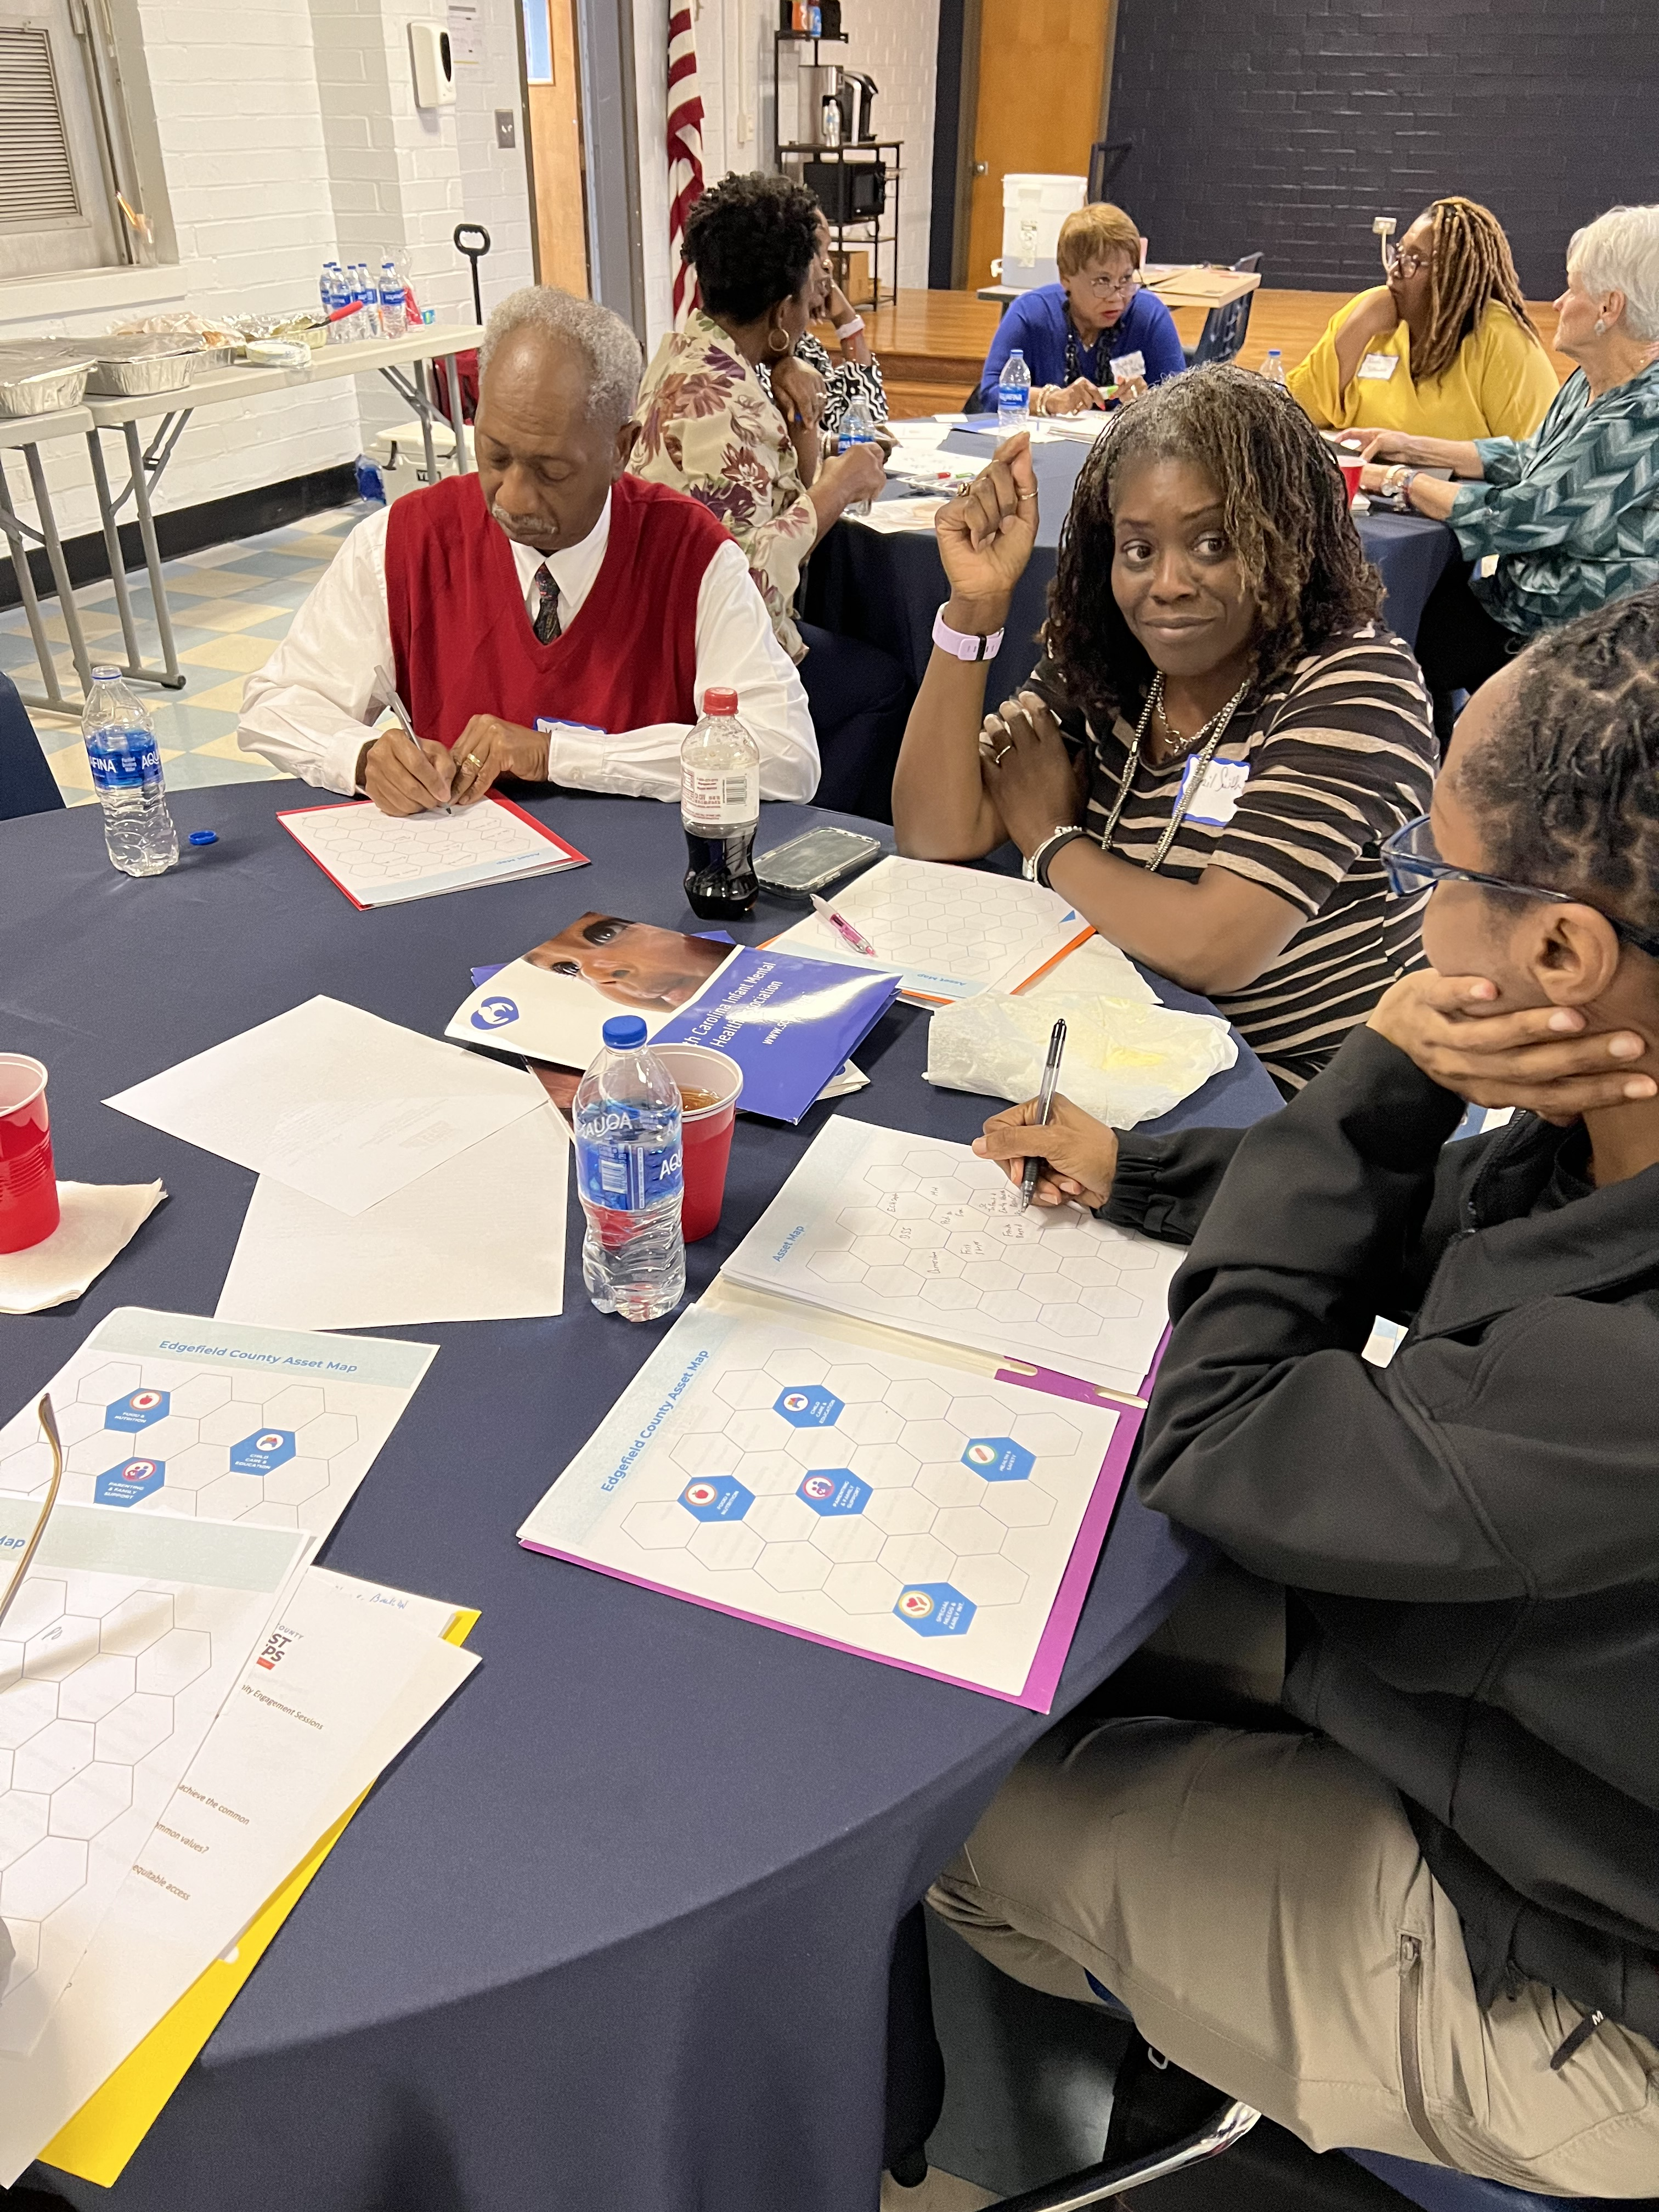
Priorities: Summary
1. Increase Community Awareness of Available Resources
2. Provide More Opportunities for Parent Education
3. Assist Childcare Centers with Quality Training and Improvements and Provide Assistance for Families to Afford Quality Child Care
4. Provide Tutoring to Children Identified With Needing Extra Support to Master Age/Grade Level Skills
“I am definitely going to take
back the information and resources that were shared
during this meeting.”
Gladys Mason,
Investigator,
Edgefield County
Sheriff’s Office

Slide 8

Priority One: Increase Community Awareness of Available Resources
35% of Parents and 36% of Community Partners state that Resources in our Community are Hard to Locate, Cannot Locate, or are Unsure of How to Locate
Data Source: Edgefield County First Steps Needs and Resources Assessment, January – February 2023
“This needs assessment was very informative. Even though I have been in this county all my life, I learned of many resources for families I did not know. Also, my thoughts of what I learned is that we need to communicate more and in a variety of ways to let families know what is available.”
Dr. Sallie Cooks,
Mt. Canaan Baptist Church
Power One Family Ministries

Slide 9
Priority Two: Provide Opportunities for Parent Education and Support
84% of Community Partners state that parents needing parenting skills are one of the top 3 reasons why children are not ready for school.
Data Source: Edgefield County First Steps Needs and Resources Assessment, January – February 2023
Additional information from the Edgefield County First Steps Needs Assessment included data showing that nearly 30% of parents and over 60% of community partners would like to see Edgefield County First Steps offer parenting programs in the community.

Slide 10

Priority Three: Quality and Affordable Child Care
The three licensed child care centers (apart from Early Head Start/Head Start) in Edgefield County are either still pending their ABC rating, or are rated as a C level.
Data Source: SCDSS ABC Quality Ratings
75% of parents rate the cost of child care in Edgefield County as somewhat high or high
57% of parents responded they would like affordable quality child care to be a priority for Edgefield County First Steps
“After gaining custody of my two grandsons, I didn’t know what we were going to do. If it wasn’t for Edgefield County First Steps, we would have been been in a bad situation. They have helped tremendously with providing us scholarships for daycare so we could continue to work to provide for our family. We cannot be more grateful.”
Vivian McGurn, Grandmother, Edgefield County First Steps Scholarship recipient

Slide 11


Priority Four: Provide Tutoring and Support for Children to Master Age-Appropriate and/or Grade Level Skills
Only 30% of Edgefield County Kindergarteners demonstrate Readiness on the Most Recent SC Kindergarten Readiness Assessment
Data Source: South Carolina Education Oversight Committee
64% of Parents and 55% of community partners state that they would like tutoring programs for young children to be priority for Edgefield County First Steps
Data Source: Edgefield County First Steps Needs and Resources Assessment, January – February 2023

Slide 12




Next Steps
PLAN
Write the partnership’s three-year Strategic Plan using the Needs Assessment
March 2023 – May 2023
APPLY
Utilize the Strategic Plan to inform the partnership’s Annual Formula Funding Grant Application
May 2023, May 2024, May 2025
IMPLEMENT
Execute the programs and services outlined in the Strategic Plan
July 2023 –June 2026
MONITOR
Track the partnership’s progress on implementing programs to fidelity and on achieving the Strategic Plan
July 2023 – June 2026

