Slide 1


COMPREHENSIVE PLAN
2024 – 2026
STRATEGIC PLAN
Notes:
This is the COVER of your comprehensive plan. Delete the placeholder logo and replace it with your county logo. From the Insert tab, select Pictures. Browse to the folder where your “color w white text” logo is stored. Select it and click Open. After the logo appears, double-click it to open the Format tab. Resize by clicking in the Width box and entering 2.5. Align the logo with the comprehensive plan title below.

Slide 2

Mission
First Steps empowers Edgefield County families and caregivers to prepare children for school success by delivering, enhancing, and expanding high-quality early childhood services.
Vision Every Edgefield County child will be prepared for success in school.
Values
The years of early childhood are critical windows of development during which much of human potential is shaped.
All children are inherently worthy of receiving the best possible start in life and are the most valuable resource for the future of our community. Responsive, nurturing relationships with consistent caregivers in a safe, stimulating learning environment create the best possible chance for children’s healthy development and school readiness.
Families are the single most important influence on the development of young children.
The work of supporting families and caregivers is a collaborative effort between state and local stakeholders within the public, private, and faith sectors.
School readiness is the result of a child’s development in many areas - including physical development, approaches to learning and inquiry, social and emotional development, language and literacy development, and mathematical thinking - with each contributing to the child’s success.
We value and demonstrate diverse perspectives in the development of programs. Services must be individualized and adaptable to meet the unique needs of children and families and we ensure that all families have the opportunity to be successful.
Services must be high-quality and have evidence of success. First Steps operates within a culture of accountability.
Notes:
LOGO: Delete the placeholder logo and replace it with your county logo. From the Insert tab, select Pictures. Browse to the folder where your “color w white text” logo is stored. Select it and click Open. After the logo appears, double-click it to open the Format tab. Resize by clicking in the Width box and entering 2. Place the image in the center of the blue header. From the Format tab, click Align > Align Center.

Slide 3

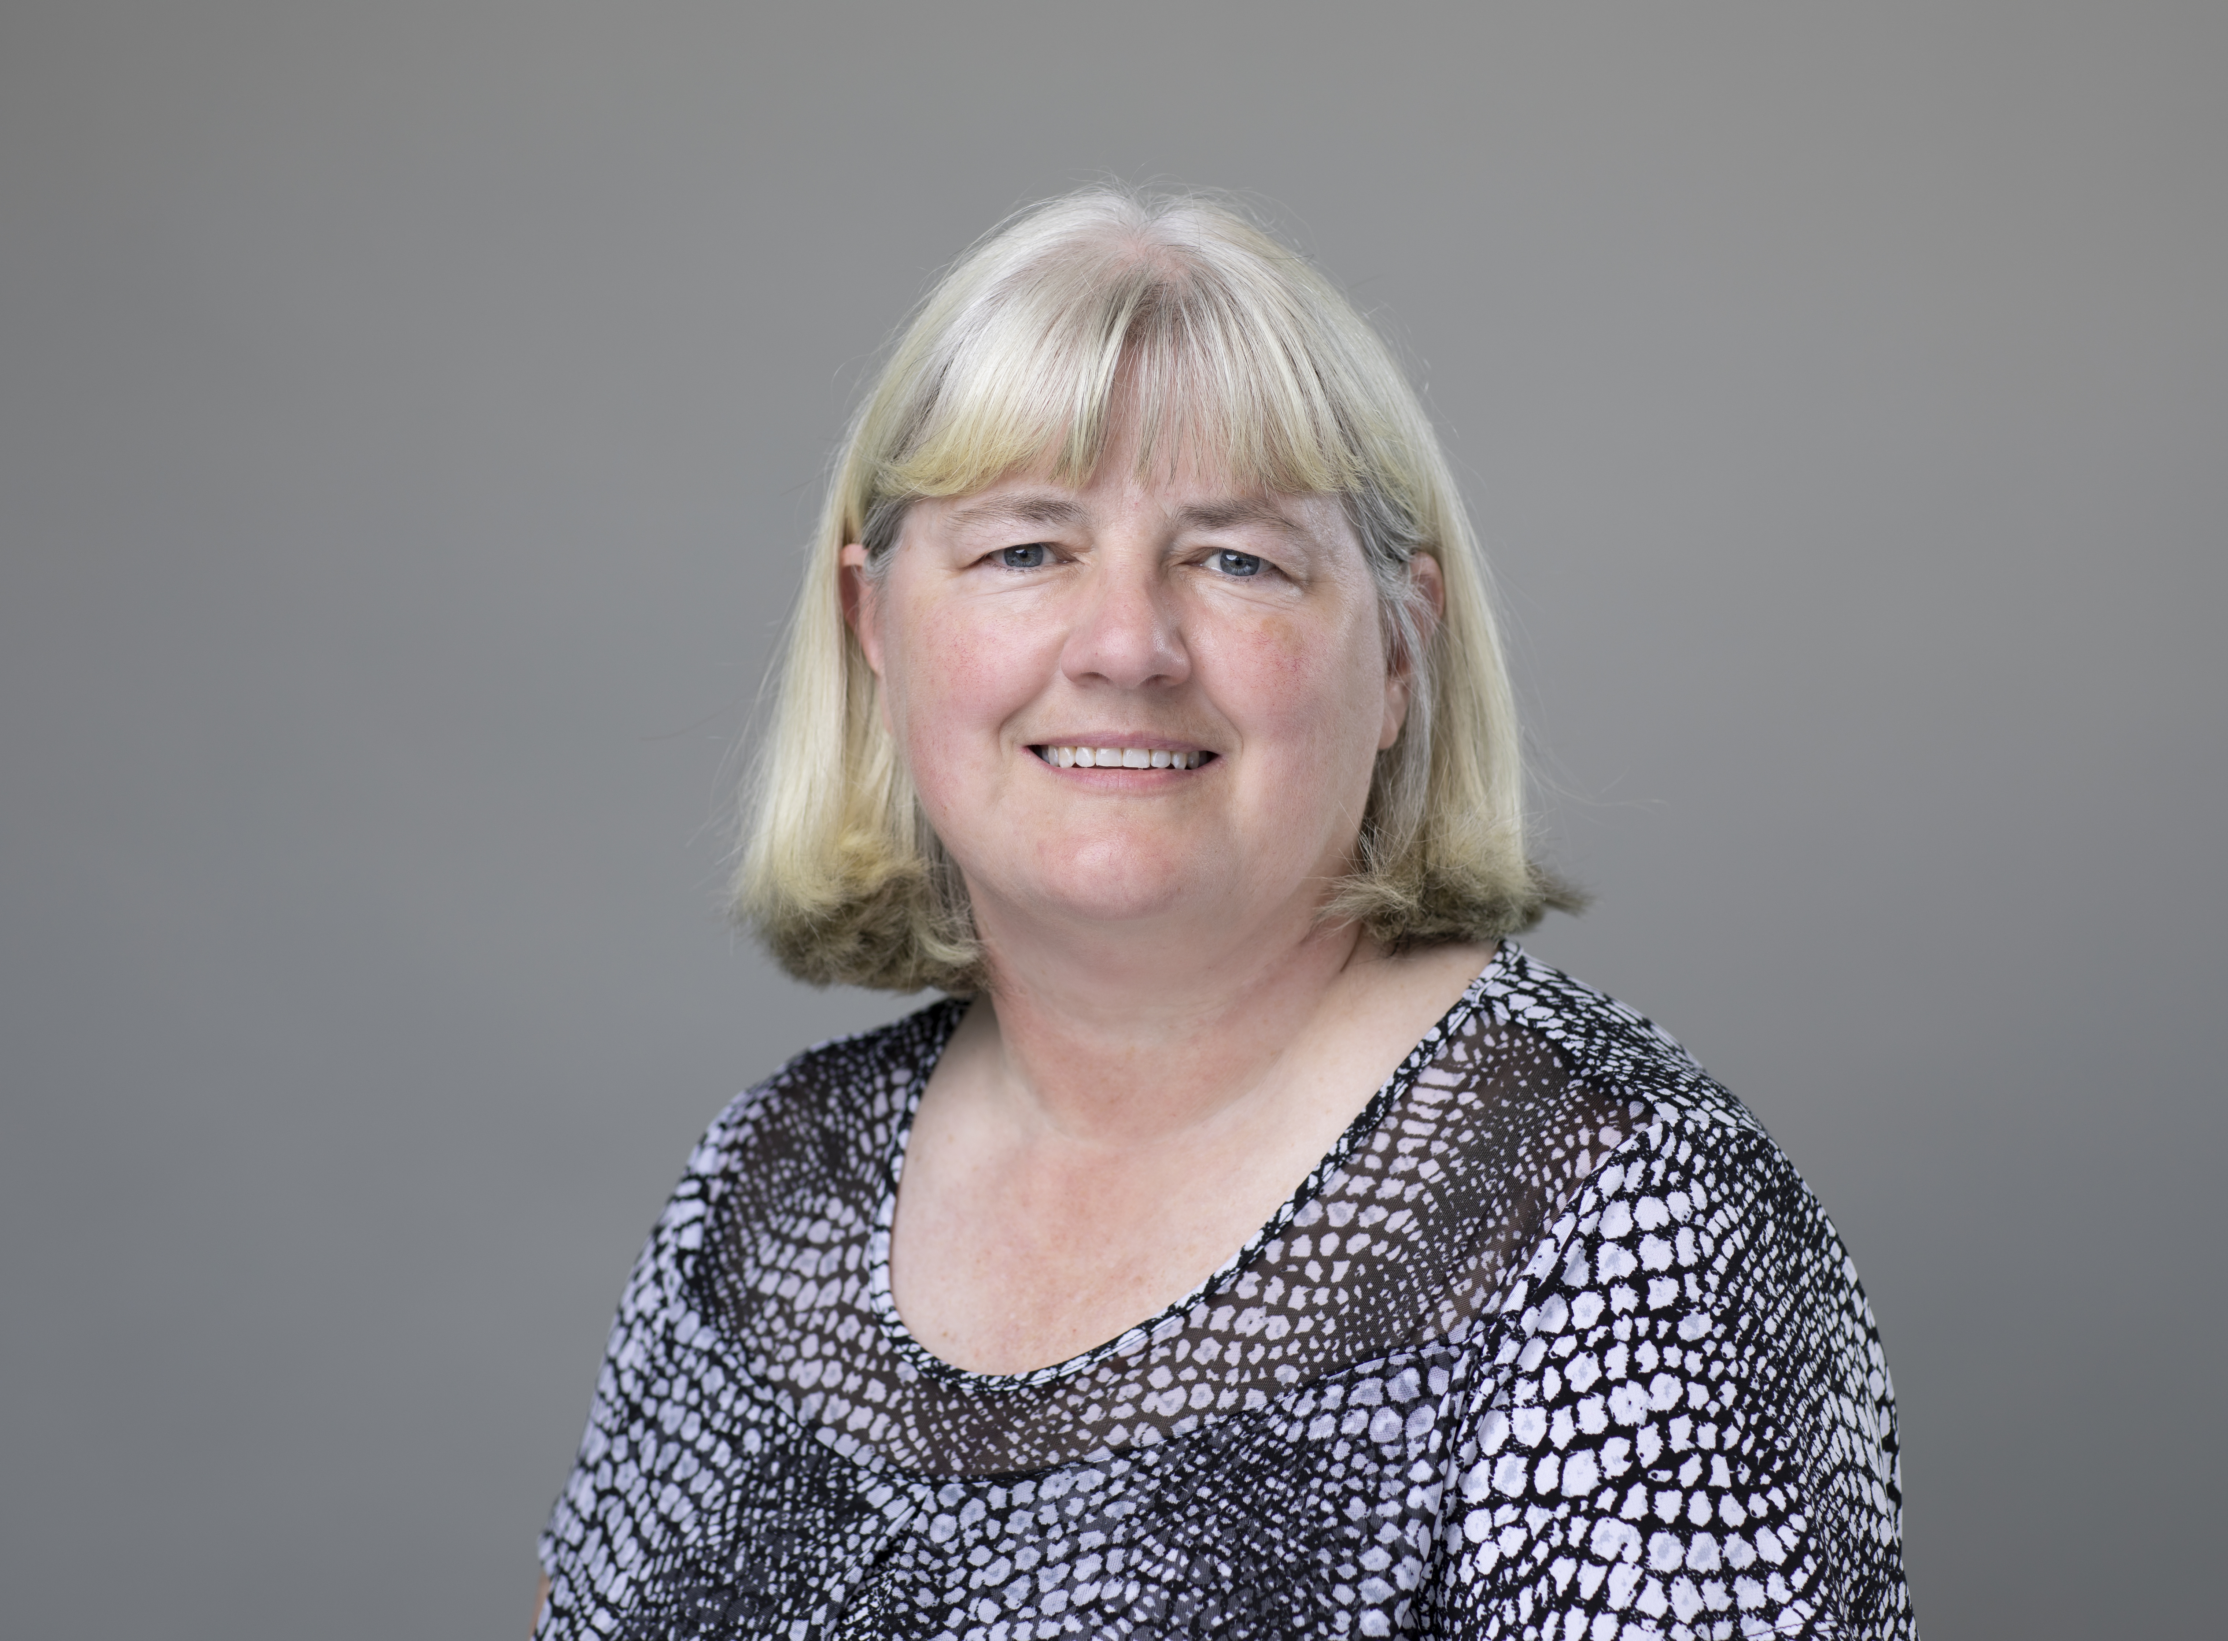
Message from the Executive Director
Candi Lalonde
Executive Director
Edgefield County First Steps
On behalf of the Edgefield County First Steps Partnership Board, I am proud to present the Edgefield County First Steps Strategic Plan for 2024-2026.
This plan represents several months of work that involved focus groups, community surveys, and interviews with key community and agency staff across Edgefield County.
Our Partnership Board of Directors renews our commitment to our mission, vision, and core values as part of our efforts to provide high-quality, affordable, and equitable programs for the young children and their families in Edgefield County.
Candi Lalonde
Notes:
TEXT: Use the text boxes provided to give an introduction to your partnership and outline your goals.
PHOTO & SIGNATURE: Delete the placeholder images and replace them with a high-quality photo and signature. (Insert > Pictures.) Double-click the images to open the Format tab, where you can crop and resize these images. Edit the text box below the ED photo with ED name and partnership name.

Slide 4







Strategic Plan Process
CONVENE
Distributed over 500 surveys to parents with
young children and community partners
Held two community convenings with 20 participants
and developed a vision for young
children and their families
January - February 2023
UNDERSTAND
Reviewed local data and map assets to understand the state of young children, their families, and the early childhood system
January –February 2023
PRIORITIZE
Organized the insight gathered from the convenings and data to prioritize the concerns, needs, and gaps the partnership wants to address and formalized Needs Assessment
February 2023 –March 2023
PLAN
Wrote the partnership’s three-year Strategic Plan using the Needs Assessment
March 2023 – May 2023
APPLY
Utilize the Strategic Plan to inform the partnership’s Annual Formula Funding Grant Application
May 2023, May 2024, May 2025
IMPLEMENT
Execute the programs and services outlined in the Strategic Plan
July 2023 –June 2026
MONITOR
Track the partnership’s progress on implementing programs to fidelity and on achieving the Strategic Plan
July 2023 – June 2026

Slide 5
Priority Needs: Summary
Through a series of community convenings, a needs assessment, and an asset mapping process, the following needs were prioritized for Edgefield County.
1. Increase Community Awareness of Available Resources
          35% of parents and 36% of community partners state that resources in our community are hard to locate, cannot locate, or are unsure of how to locate.
2. Provide More Opportunities for Parent Education
84% of community partners state that parents needing parenting skills are one of the top 3 reasons why children are not ready for school.
3. Assist Childcare Centers with Quality Training and Improvements and Provide Assistance for Families to Afford Quality Child Care
The three licensed child care centers (apart from Early Head Start/Head Start) in Edgefield County are either still pending an ABC rating, or are rated as a C level.
57% of parents responded they would like affordable quality child care to be a priority for Edgefield County First Steps.
4. Provide Tutoring to Children Identified With Needing Extra Support to Master Age/Grade Level Skills
Only 30% of Edgefield County Kindergarteners demonstrate readiness on the most recent SC Kindergarten Readiness Assessment.
64% of parents and 55% of community partners state that they would like tutoring programs for young children to be priority for Edgefield County First Steps
See our full needs assessment here: www.edgefieldfirststeps.org
Notes:
INSTRUCTIONS. Copy this page directly from your needs assessment document.

Slide 6
Objectives
1. Increase community awareness about programs, services, and resources offered not only by Edgefield County First Steps, but other community partners as well
2. Ensure that high quality programs will be accessible, equitable, and affordable for Edgefield County families
3. Provide education and support for families as their child’s first and most important teacher
4. Provide tutoring and support for children to master age-appropriate and/or grade level skills

Slide 7
Objective One: Increase Community Awareness About Programs, Services, and Resources Offered by Edgefield County First Steps and Other Community Partners
STRATEGY 1.1
Increase presence at community events and local meetings
  SMART GOAL(S)
  We will participate in at least 4 community events yearly, to include parent education for local elementary schools, Early Head Start, Head Start, and local child care centers.
  Partnership staff will attend at least 6 local interagency and community meetings yearly.
  COMMUNITY COLLABORATOR(S)
  We will partner with the local community organizations and groups that host meetings and/or events that reach children and families in the county.
STRATEGY 1.2
Increase use of local signage, brochure distribution, and both social and print media
  SMART GOAL(S)
  There will be three unique posts on our Facebook page weekly.
  There will be an article in our local newspaper three times yearly.
  Brochures and signage will be placed in at least 12 locations throughout the county.
  COMMUNITY COLLABORATOR(S)
  We will partner with local agencies and businesses to acquire space for brochures and signage.
Notes:
REPLACE the word objective with the first objective you chose. You must select at least one strategy per objective. For each strategy, select at least one SMART goal and identify at least one community collaborator. DELETE any text you do not use. If you need more pages for your objectives or strategies, DUPLICATE THIS SLIDE and change the numbers to correspond.

Slide 8
Objective One: Increase Community Awareness About Programs, Services, and Resources Offered by Edgefield County First Steps and Other Community Partners (cont.)
STRATEGY 1.3
Imagination Library
  SMART GOAL(S)
  By FY 26, we will increase our enrollment in the Dolly Parton’s Imagination Library program by 10%. When receiving enrollment forms by mail from families that we do not serve in other programs, we will send additional information to them to ascertain if they can benefit from any of our other programs.
  COMMUNITY COLLABORATOR(S)
  We will provide enrollment forms for our community providers who serve families with young children (Edgefield County Health Department, Edgefield County Department of Social Services, and Early Head Start) so they can assist us with enrolling more children.
STRATEGY 1.4
County Resource Directory
  SMART GOAL(S)
  We will work with community partners to develop both a print and an online county resource directory by early 2024.
  COMMUNITY COLLABORATOR(S)
  We will partner with the Edgefield County Interagency Council and other community partners in this effort.
Notes:
REPLACE the word objective with the first objective you chose. You must select at least one strategy per objective. For each strategy, select at least one SMART goal and identify at least one community collaborator. DELETE any text you do not use. If you need more pages for your objectives or strategies, DUPLICATE THIS SLIDE and change the numbers to correspond.

Slide 9
Objective Two: Ensure That High Quality Programs Will Be Accessible, Equitable, and Affordable For Edgefield County Families
STRATEGY 2.1
Early Education for Children Under 4
  SMART GOAL(S)
  By FY 26, the number of children enrolled in quality early education programs will increase by 10%.
  COMMUNITY COLLABORATOR(S)
  We will work with the Edgefield County School District to provide funding for staffing for the early childhood education classroom.
STRATEGY 2.2
Child Care Scholarships
  SMART GOAL(S)
  By FY 26, we will increase the number of child care scholarships awarded by 10%.
  COMMUNITY COLLABORATOR(S)
  We will work with the licensed child care providers in Edgefield County to recruit and refer families for child care scholarships that we will offer via the ABC Scholarship program.
Notes:
REPLACE the word objective with the second objective you chose. You must select at least one strategy per objective. For each strategy, select at least one SMART goal and identify at least one community collaborator. DELETE any text you do not use.
If you need more pages for your objectives or strategies, DUPLICATE THIS SLIDE and change the numbers to correspond.

Slide 10
Objective Two: Ensure That High Quality Programs Will Be Accessible, Equitable, and Affordable For Edgefield County Families (cont.)
STRATEGY 2.3
Child Care Quality Enhancement (QE) and Training
  SMART GOAL(S)
  By FY 26, we will increase the number of certified training hours offered each year by 10%.
  By FY 26, the number of licensed child care, family child care, and early childhood education staff members who attend at least 10 hours of certified training provided by Edgefield County First Steps will increase by 10%.
  By FY 26, the average number of monthly coaching visits to the centers enrolled in our child care quality enhancement program by our child care technical assistant will increase by 10%.
  BY FY 26, the average ABC Quality rating of licensed child care centers participating in our QE program will increase to a B or better.
  COMMUNITY COLLABORATOR(S)
  We will work with all licensed child care providers; group and family home providers; private and church preschool providers; Early Head Start and Head Start; and the Edgefield County School District 4K programs to provide quality trainings that meet their training and professional development needs.
Notes:
REPLACE the word objective with the second objective you chose. You must select at least one strategy per objective. For each strategy, select at least one SMART goal and identify at least one community collaborator. DELETE any text you do not use.
If you need more pages for your objectives or strategies, DUPLICATE THIS SLIDE and change the numbers to correspond.

Slide 11
Objective Three: Provide Education And Support For Families As Their Child’s First and
Most Important Teacher
STRATEGY 3.1
Nurturing Parenting
  SMART GOAL(S)
  By FY 26, we will increase the number of families enrolled in Nurturing Parenting by 10%.
  COMMUNITY COLLABORATOR(S)
  We will work with the Edgefield County School District, the Department of Social Services, Head Start/Early Head Start, local physicians’ offices, and Cornerstone to get referrals for our program.
STRATEGY 3.2
Nurse Family Partnership
  SMART GOAL(S)
  By FY 26, we will increase the number of families enrolled in Nurse Family Partnership by 10%.
  COMMUNITY COLLABORATOR(S)
  We will work with the Edgefield County Health Department, the Edgefield County Department of Health and Human Services, the Edgefield County Department of Social Services, local physicians’ offices, and the Edgefield County School District to get referrals for our program.
Notes:
REPLACE the word objective with the third objective you chose. You must select at least one strategy per objective. For each strategy, select at least one SMART goal and identify at least one community collaborator. DELETE any text you do not use. If you need more pages for your objectives or strategies, DUPLICATE THIS SLIDE and change the numbers to correspond.

Slide 12
Objective Four: Provide Tutoring and Support For Children To Master Age-Appropriate and/or Grade Level Skills
STRATEGY 4.1
Enhanced Early Education
  SMART GOAL(S)
  1. By the end of FY 26, we will increase the number of children served through our Enhanced Early Education (EEE) program by 10%
  COMMUNITY COLLABORATOR(S)
  We will partner with the Edgefield County School District to identify children who are prioritized as most in need of services and support, as identified by SC First Steps risk factors and/or student assessment information (examples include MAP, PALs, and/or WIDA scores).
STRATEGY 4.2
Countdown to Kindergarten/Countdown to 4K
  SMART GOAL(S)
  1. By the end of FY 26, we will increase the number of children enrolled in CTK and/or CT4K services by 10%.
  COMMUNITY COLLABORATOR(S)
  We will partner with the Edgefield County School District to identify teachers and children who will participate in the program.
Notes:
REPLACE the word objective with the third objective you chose. You must select at least one strategy per objective. For each strategy, select at least one SMART goal and identify at least one community collaborator. DELETE any text you do not use. If you need more pages for your objectives or strategies, DUPLICATE THIS SLIDE and change the numbers to correspond.

Slide 13
Overarching Measure of Success
INCREASE THE NUMBER OF CHIDREN ENROLLED IN HIGH INTENSITY PROGRAMS FUNDED BY FIRST STEPS
By FY 26, the percentage of children and families enrolled in high intensity programs funded by Edgefield County First Steps will increase from 5% to 15%.
Notes:
OVERARCHING MEASURES OF SUCCESS. Please select one (or more) of the overarching measures of success for your 2024-2026 strategic plan and list them here. Whichever you select, reflect on how the overarching measure(s) of success align with the strategic goals of your local Partnership, and your board. Remember to use the quantitative and qualitative data you collected in your Needs and Resources Assessment to inform Comprehensive Plan objectives. Edit the title, deleting “(s)” if you have one overarching measure of success, or deleting the parentheses if you have two or more.

Slide 14
Acknowledgments
The process to complete this Strategic Plan began with the Edgefield County First Steps Needs and Resources Assessment process. Surveys were distributed to community partners and parents with young children.
These survey results were tabulated and additional sources were utilized for data reports, including KidsCount, County Health Rankings and Roadmaps from the University of Wisconsin Population Health Institute, the South Carolina Department of Social Services, South Carolina DHEC Vital Records, the South Carolina Education Oversight Committee, and the American Community Survey 5-Year Estimates (2016-2020).
Community meetings were held in February 2023 with participants attending representing the local school district, local child care providers, Early Head Start, faith community, Adult Education, Family Literacy, local charter school, law enforcement, mental health, and local non-profit organizations. The attendees reviewed data relevant to young children and their families and brainstormed the vision and values of an early childhood system where all children reach their highest potential and mapped the county resources/assets and identified needs of the community. The meetings concluded with the group discussing the gaps in the resources.
Edgefield County First Steps wants to acknowledge those who completed surveys as well as the attendees at the community meetings. All contributions were invaluable as we completed our needs and resources assessment, which then informed our 2024-2026 Strategic Plan.
“The project described was supported through South Carolina First Steps by the Preschool Development Grant Birth through Five Initiative (PDG B-5), Grant Number 90TP0080-02-01 from the Office of Child Care, Administration for Children and Families, U.S. Department of Health and Human Services.”

